Slide 1
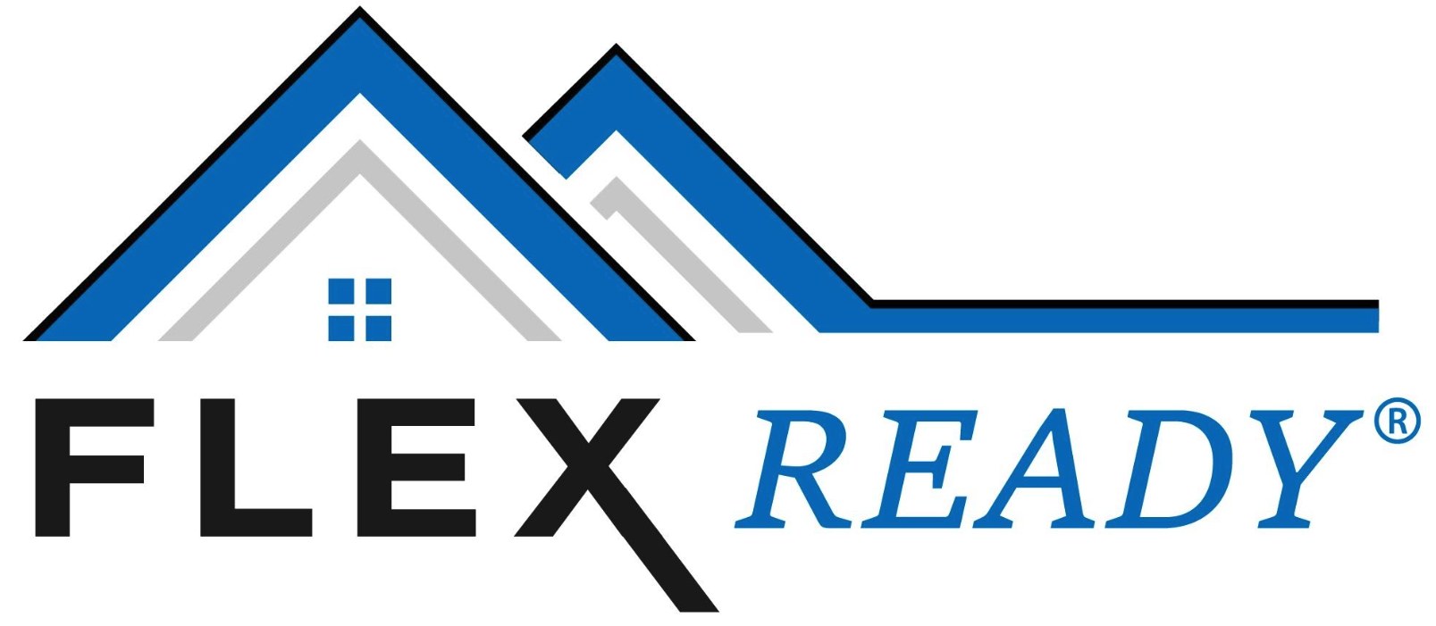
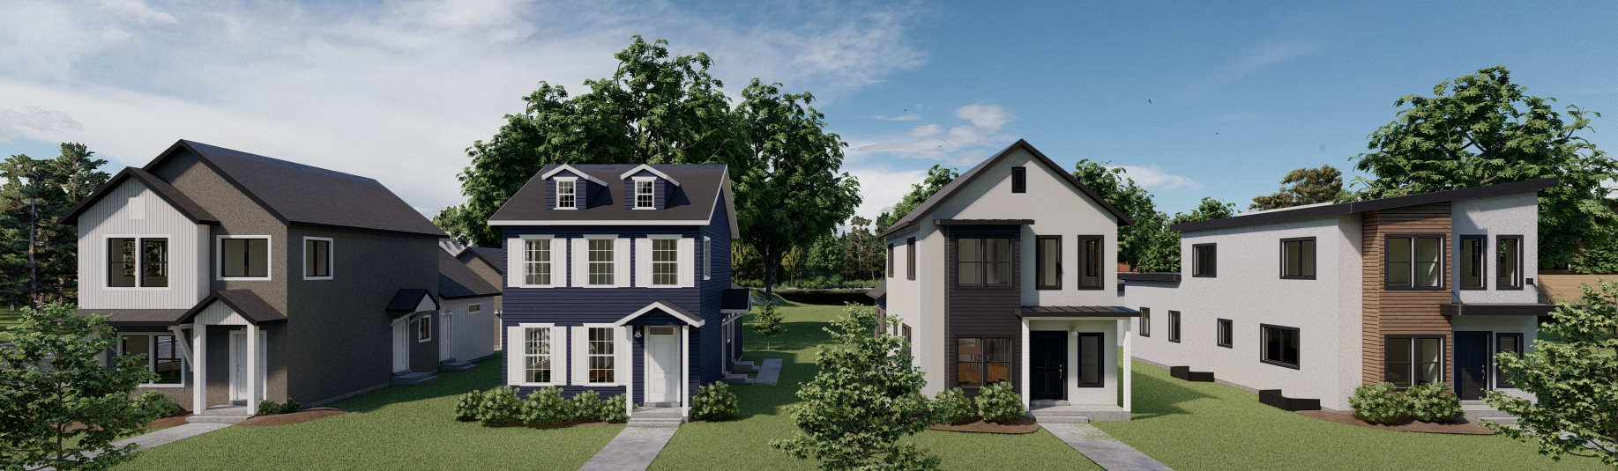

Slide 2
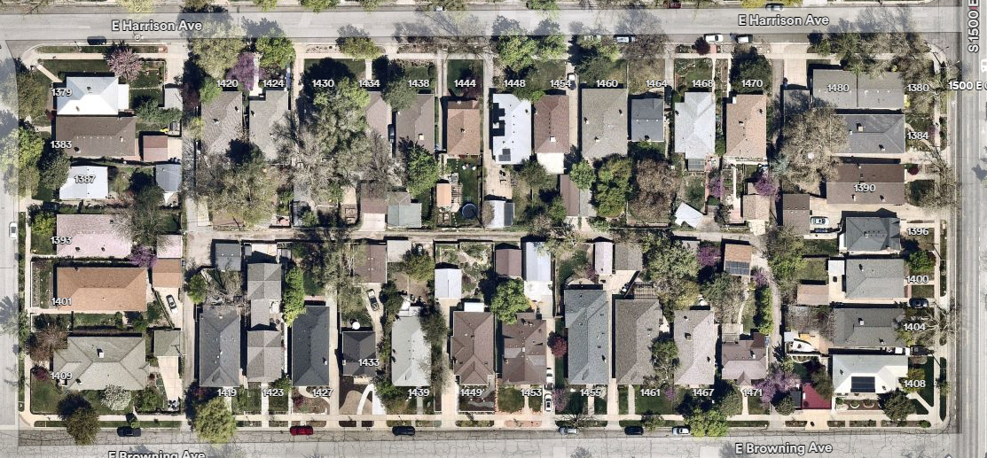
Affordable Single-Family Homes and The Missing Middle
It hasn’t always been missing. Let’s look back…Sugar House, Avenues, Daybreak

Slide 3
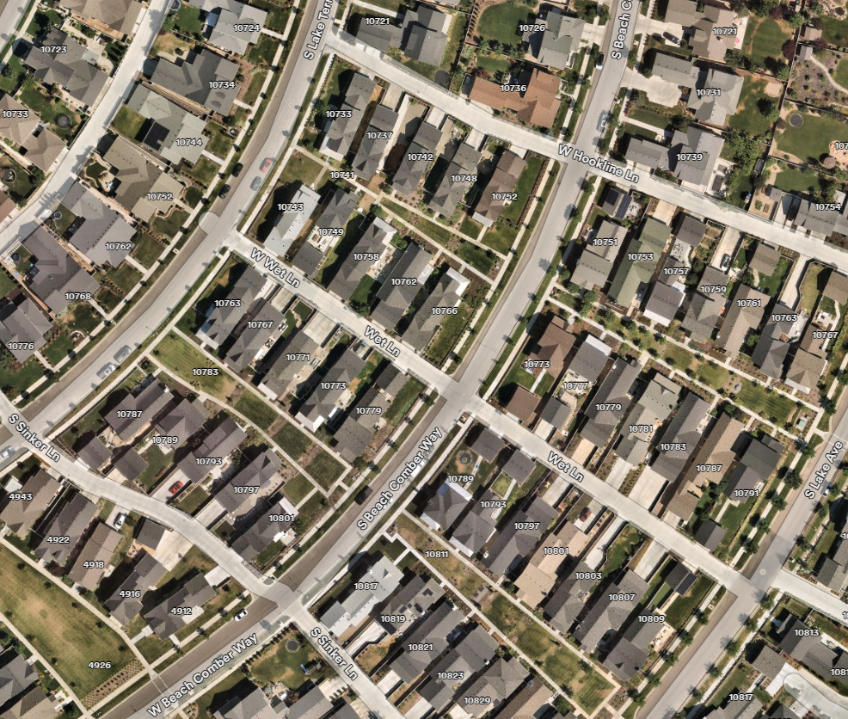
The Missing Middle: Key Elements
Tree lined streets
Not garage dominant
Alley load, shared drives
40 foot +/- frontages
4,000 sf +/- lots
Unique front elevations
We can't build these single-family neighborhoods in most Utah cities today

Slide 4
What Happened?
Regulatory focused to “protect” larger lot values, shifting density to townhomes/apartments
    Garage dominated with wider frontage requirements, lot size minimums….
      “Just build your home and grow into it…”
      It worked when land was affordable, infrastructure costs were lower
Townhome developments became the focus for “affordability”
      10+ units per acre, 2 car parking, garage dominant
      Architectural “efficiency”, limited differentiation
      Zoned out of single-family areas
      Affordability focus now shifting to build-to-rent vs. ownership

Slide 5
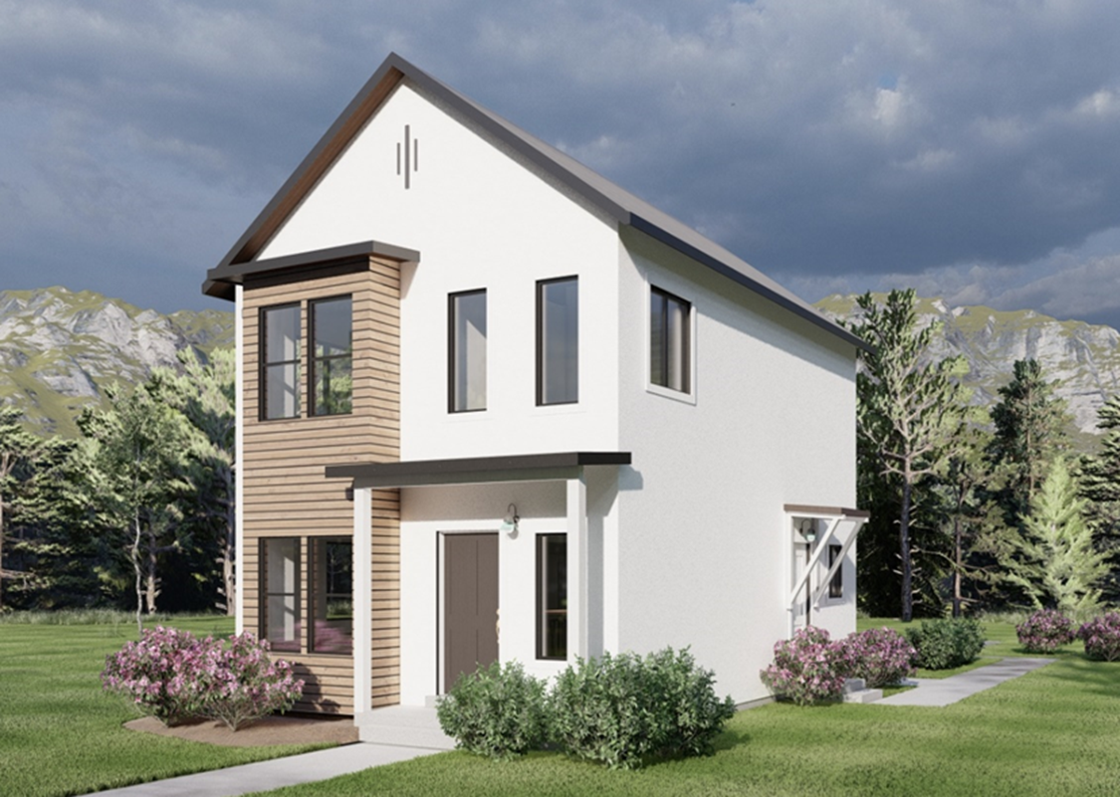
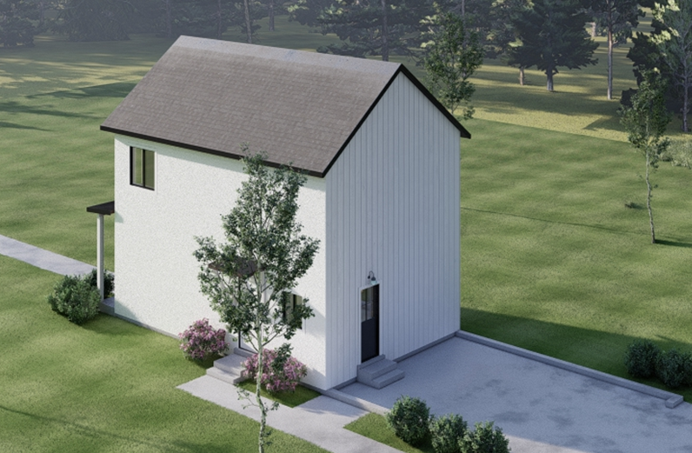
FlexReady Brings Back the Misssing Middle…Starting in the low $300s
  Efficient base home…..get into the market NOW to start building equity!
    Example: 1,200 sf 2-Story…open main floor living, 3 Bed 1.5 Bath
    FlexReady works with quality builders to incorporate layouts/designs
    Integrate new innovations in processes and materials
    Expansion options built into base plan!

Slide 6
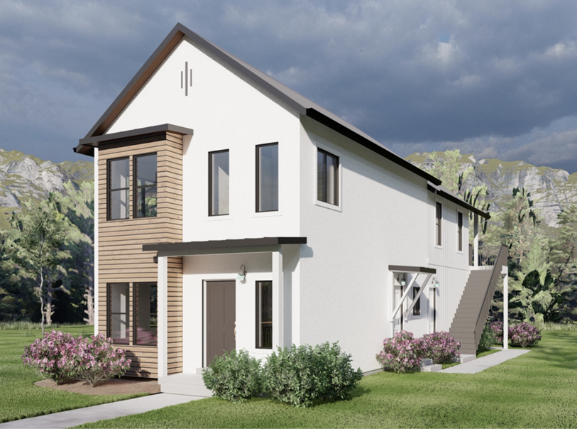
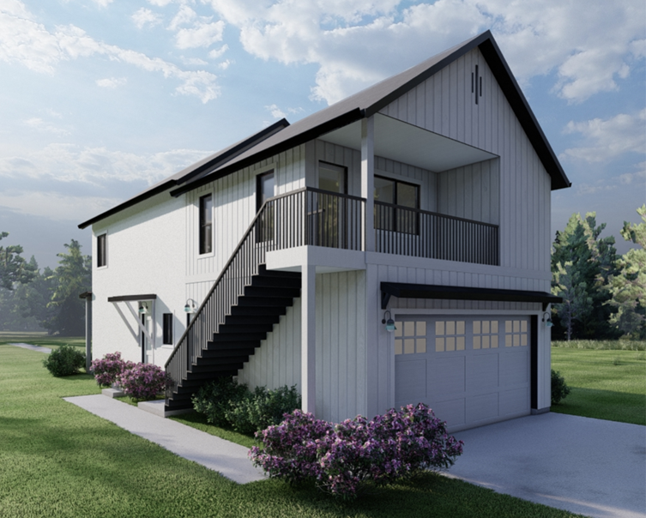
FlexReady Brings Back the Misssing Middle…Starting in the low $300s
  Expansion ready….ALL design elements/connections built-in
    Expand when you are ready for less than the cost of new construction
      Build your garage ….Utah-S.B. 181 THANKS
      Options to go to 6 Bed/4.5 Bath..…..A Home You Grow Into, Not Out Of…
    FlexReady stays with the homeowner for 5 years as they build equity for expansion
      Preferred contractor, pricing transparency, preferred lenders on MEMBER WEBSITE
  Rental / multi-generation flexibility
FlexConnections
Concrete
Plumbing
Electrical
Roofing
Structural
HVAC

Slide 7
But…..
We need regulatory flexibility for single-family homes…just like we had in the past:
  Regulatory flexibility drives Market Based Solutions
  Smaller single-family lots reduce finished land costs to $50-120k…FlexReady innovations can do the rest to bring affordability back to Utah homebuyers
      35-40 foot minimum frontages
      4,000 sf lot size minimums with alley load options
  Handout: General Plan Initiatives (10-9a-403 (2)(b)(z)
  Our Request: Integrate affordable single-family homes back into Utah developments with a state-wide zoning overlay for 10%+ smaller single-family lots to be a conforming use

Slide 8
Meanwhile….
We are working all the angles:
Utah - S.B. 181 is a great first step…
Building in new R-1B Zone in Ephraim that just passed this month (40 ft frontages)
Connecting foundations/breezeways of single-family homes to qualify them as “Townhomes/Multi-family” in Tooele/Nephi
Working with larger developers as part of a Master Development Agreement to allocate a portion to smaller lots for FlexReady Homes
    Smaller developers do not have this option!
Expanding to West Tennessee’s growing market with flexible zoning
Leveraging FlexReady in Hawaii to meet their 51% affordable homes target
Video Example: https://youtu.be/dkIbSyAzNjw

